Slide 1


CO-OP Project at Industry (Module-2)
Artificial Intelligence Driven Threat Detection in Modern Cybersecurity Systems
Jiya Jain, Srishti Garg, Aradhna
Bachelor of Engineering | Computer Science
Supervised By: Industry Mentor/Team Lead
Department of CSE, Chitkara University, Punjab

Slide 2

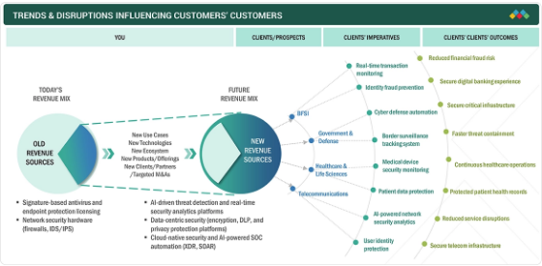
1. INTRODUCTION
Cybersecurity has shifted from rule-enforcement to a continuous inference problem.
• High-volume telemetry from firewalls & logs.
• Traditional systems fail against "low-and-slow" attacks.
• AI enables learning from historical data to flag unseen intrusions.
• Motivation: Balancing false alarms with threat coverage.

Slide 3
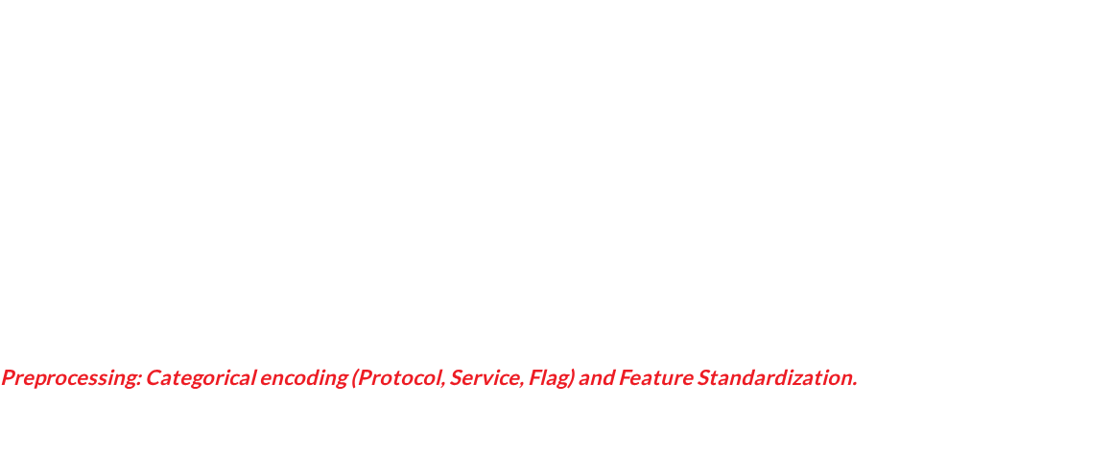





2. METHODOLOGY: NSL-KDD DATASET
Benchmark Data
41 Features
Class Taxonomy
Utilized NSL-KDD, a refined version of KDD Cup 99, to reduce redundancy and improve accuracy.
Covers basic connection properties, traffic content indicators, and host-based statistics.
Binary (Normal vs Attack) and Multi-class (DoS, Probe, R2L, and U2R families).

Slide 4

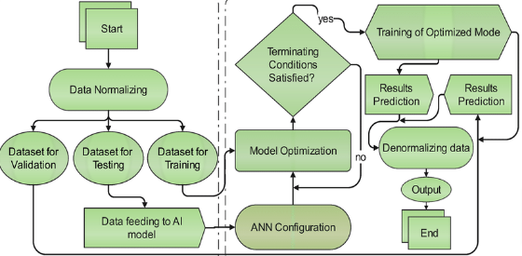
3. TOOLS & TECHNOLOGIES
Algorithms Evaluated
•
XGBoost: Gradient Boosting for speed.
•
Random Forest: Ensemble accuracy.
•
Decision Tree: Rule-based explainability.
•
SVM & ANN: Complex nonlinear patterns.
•
Isolation Forest: Anomaly scoring.
Stack: Python, Scikit-Learn, TensorFlow, Keras.

Slide 5


4. HYBRID EXTENSION FRAMEWORK
Combining Supervised certainty with Unsupervised suspicion for "Zero-Day" detection.
Autoencoder (A)
Isolation Forest (I)
Structure (S)
Measures reconstruction error of normal traffic patterns.
Identifies outliers in sparse regions of feature space.
Integrates contextual or structural threat signals.

Slide 6
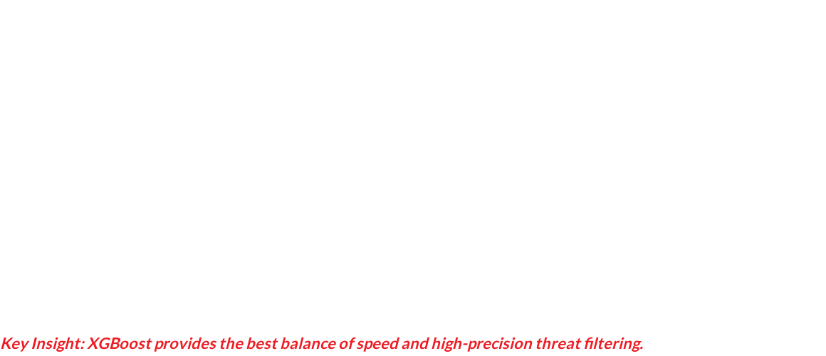

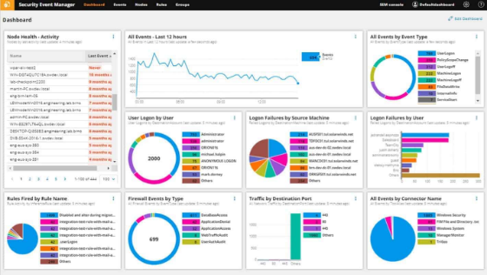
5. BINARY CLASSIFICATION RESULTS
Model | Accuracy | Precision | Recall | FPR
XGBoost | 80.09% | 96.78% | 67.26% | 2.96%
Decision Tree | 78.77% | 96.49% | 65.07% | 3.13%
SVM | 78.19% | 97.57% | 63.27% | 2.08%
ANN | 77.30% | 97.15% | 61.93% | 2.40%

Slide 7
6. MULTI-CLASS CLASSIFICATION
Attack Family Performance
Model | Acc (%) | F1 (%)
Decision Tree | 76.80 | 73.52
XGBoost | 75.74 | 71.04
Random Forest | 75.00 | 70.72
Decision Trees perform best in multi-class tasks due to their ability to capture complex feature interactions with explainable rules.

Slide 8
7. MAJOR FINDINGS & DATA INSIGHTS
Top Threat Signals
•
Service: Critical indicator of target vulnerability.
•
Src_Bytes: Fundamental to volumetric DoS detection.
•
Dst_Host_Srv_Count: Key for probe/recon detection.
Training time analysis shows tree-based models process traffic 10x faster than SVM, crucial for Line-Rate Processing.

Slide 9


8. CONCLUSION & FUTURE SCOPE
Outcome
Recall Gap
Future
XGBoost and Decision Trees are the strongest production baselines for structured tabular cybersecurity data.
Supervised models alone leave a 30% gap in attack coverage, necessitating the hybrid anomaly extension.
Moving beyond static records to Sequential Analysis using Recurrent Neural Networks (RNNs).
Integrating Explainable AI (XAI) via SHAP values to help SOC analysts interpret machine learning triage decisions.

Slide 10
THANK YOU
Questions & Feedback
Jiya Jain | Srishti Garg | Aradhna
Department of CSE, Chitkara University
Email: [Student IDs]@chitkara.edu.in

